Slide 1
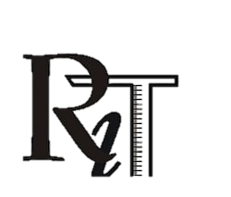

Rajeev Institute of Technology
Plot 1-D, Growth Center, Industrial Area, B-M Bypass Road, Hassan ,Karnataka
Department of Computer Science and Engineering (AI&ML)
A Mini Project Presentation
On
“IoT-Based Smart Irrigation System”
Presented By
4RA24CI405
4RA24CI408
4RA23CI409
Under the Guidance of
Mr. Lohith D K
Assistant Professor
Dept. of CSE (AI&ML)
Jeevan HM
Sanjay VB Shashank BM

Slide 2
Abstract
The Internet of Things (IoT) has introduced innovative solutions to address challenges in agriculture, particularly in water management.
Traditional irrigation practices are often inefficient, consuming excessive water and requiring continuous human effort.
An IoT-based smart irrigation system integrates sensors, microcontrollers, and wireless communication to monitor soil moisture, temperature, and environmental conditions in real time.

Slide 3
Contents
Abstract
Contents
Introduction
Literature Survey
Problem Statement
Existing System
Objectives
System Architecture
Flow Chart
Advantages
Requirements Hardware/ Software
Conclusion
References

Slide 4
Introduction
Agriculture greatly relies on efficient irrigation to improve crop growth and yield. Traditional manual irrigation methods are often time-consuming, result in water wastage. The rising concern of water scarcity, there is a strong need for smart and sustainable solutions.
IoT-based smart irrigation systems use sensors and automation to monitor soil and environmental conditions in real time. This approach minimizes water usage, reduces human effort, and ensures sustainable farming practices.

Slide 5
Literature Survey
Author(s) & Year | Domain / Focus | Key Findings / Contribution
Jain et al. (2016) | IoT in Agriculture | Proposed a low-cost IoT irrigation system using soil moisture sensors and microcontrollers; reduced manual effort and water wastage.
Kim & Evans (2018) | Precision Irrigation | Developed sensor-based irrigation scheduling; improved crop yield by optimizing water supply according to soil conditions.
Rawal (2019) | IoT + Cloud Monitoring | Introduced a cloud-based smart irrigation system using Node MCU & sensors; enabled remote monitoring and real-time data storage.
Patil & Kulkarni (2020) | Automation & Control | Demonstrated automated irrigation using IoT with mobile app integration; reduced human intervention and increased efficiency.
Recent Studies (2021–2024) | Advanced Smart Systems | Integration of IoT with AI/ML for predictive irrigation, weather-based decision-making, and water conservation; challenges remain in scalability, cost, and data security.

Slide 6
Problem Statement
• Manual irrigation consumes excess water.
• Climate variability makes water management difficult.
• Farmers lack real-time monitoring of soil and crops.
• Need a low-cost, automated irrigation solution.

Slide 7
Existing System
Manual irrigation: inefficient and inaccurate.
Drip irrigation: reduces wastage but not automated.
Smart irrigation systems: high cost, limited adoption.

Slide 8
Objectives
To design an IoT-based smart irrigation system for efficient water management.
To monitor soil moisture and environmental conditions in real time.
To minimize water wastage by supplying water only when required.
To improve crop productivity and support sustainable farming practices.

Slide 9
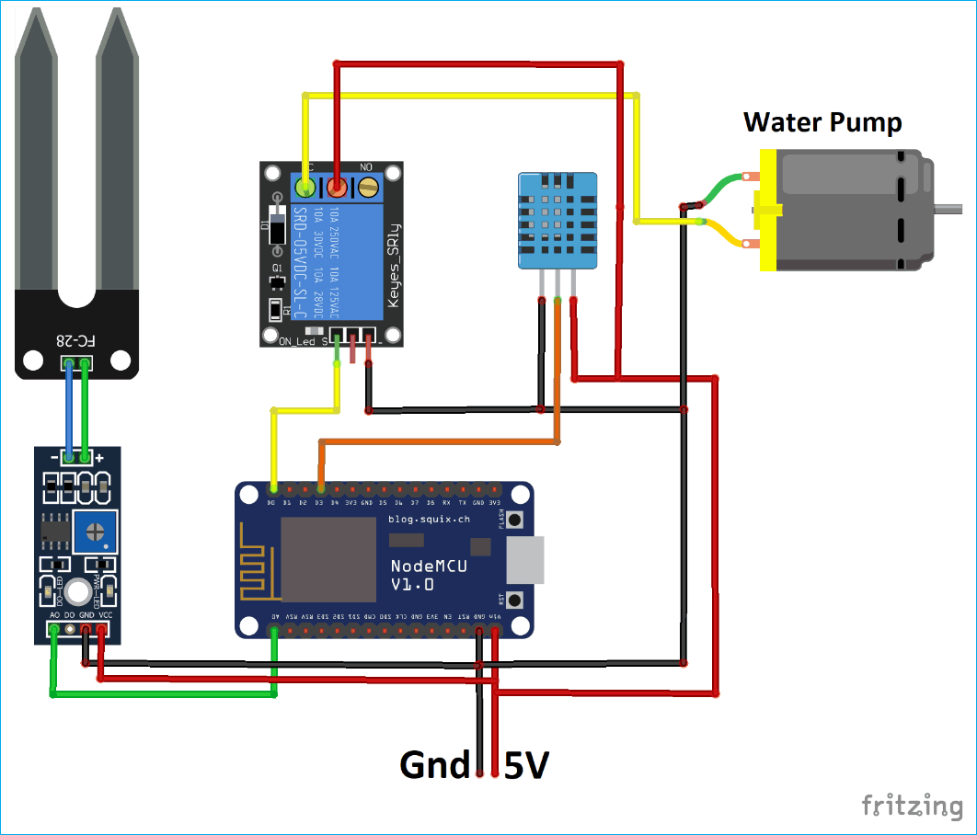
System Architecture

Slide 10
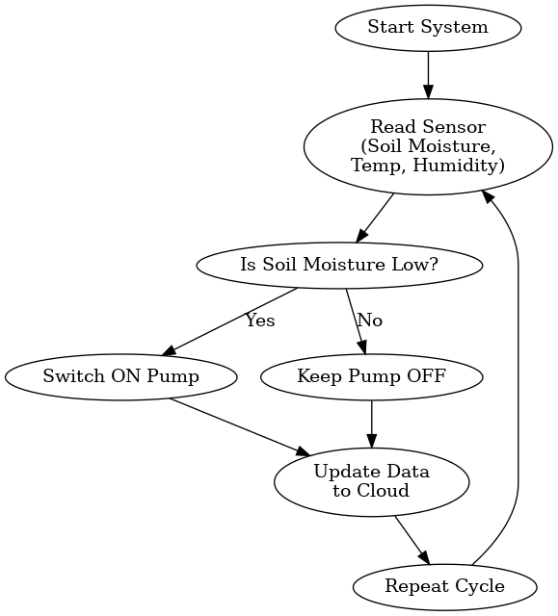
Flowchart for IoT-Based Smart Irrigation System

Slide 11
Advantages
• Reduces water wastage.
• Improves crop yield and health.
• Low cost and scalable solution.
• Provides real-time IoT-based monitoring.

Slide 12
Requirements
Hardware Components :
• ArduinoMCU ESP8266 (Wi-Fi Microcontroller).
• Soil Moisture Sensor.
• DHT11 Sensor (Temperature & Humidity).
• Relay Module.
• Water Pump & Power Supply.
Software Components :
• Arduino IDE (Programming).
• Thing Speak Cloud (Data Monitoring).
• Embedded C / C++ for coding.
• Internet connectivity for ArduinoMCU

Slide 13
Conclusion
The implementation of the IoT-based smart irrigation system successfully demonstrates the use of sensors and automation for efficient water management. By continuously monitoring soil moisture and environmental parameters, the system automatically controls the water pump based on real-time needs.
This reduces manual intervention, minimizes water wastage, and ensures timely irrigation for crops. The practical setup highlights how IoT technology can be applied in agriculture to improve productivity and sustainability.

Slide 14
References
Jain et al. (2016) – Proposed a low-cost IoT irrigation system with soil sensors and microcontroller.
Rawal (2019) – Designed a cloud-based irrigation system using Node MCU for real-time monitoring.
Patil & Kulkarni (2020) – Made an automated irrigation system with IoT and mobile app control.
Recent studies (2021–2024) – Focus on IoT + AI/ML for predictive irrigation and water-saving.

Slide 15
Thank You

